Slide 1

Vijaya Lakshmi Ambavaram
G.K Sudarshan
Pooja Pawar Shintre
Sai Chandan

Slide 2

About NSDC
443 NSDC Training Partners
8503 Training Centres
1870+ Job Roles
38 Sector skills Councils
29+6 Presence
49.10 Lakhs Placed
99.56 Lakhs Trained

Slide 3

Vision
To fulfil the growing need in India for skilled manpower across sectors and narrow the existing gap between the demand and supply of skills.
Mission
Upgrade skills to international standards through significant industry involvement and develop necessary frameworks for standards, curriculum and quality assurance.
Enhance, support and coordinate private sector initiatives for skill development through appropriate Public-Private Partnership ( PPP ) models; strive for significant operational and financial involvement from private sector.
Play the role of a ‘market-maker’ by bringing funds, particularly in sectors where market mechanisms are ineffective or missing.
Prioritize initiatives that can have a multiplier or catalytic effect as opposed to one-off impact.
Objective
To contribute significantly to the overall target of skilling up of people in India, mainly by fostering private sector initiatives in skill development programmes and to provide funding.

Slide 4
Problem Statement
R shiny dynamic Dashboard
Dynamic Dashboard to be built for NSDC top management to give them quick look at Key factors for success of training efforts undertaken by NSDC.
It will help them to take important decisions like which center/courses/packages are more helpful for higher placement success
It will give insight into important parameters for people enrolled and their performance so that courses/counselling can be designed accordingly
Employment Prediction
To predict employment of a person based on important factors like Age, Education level, state, Employment type, Centre enrolled to.
This will help to ensure the person takes right course to ensure the maximum success chances for placement of the candidate.

Slide 5
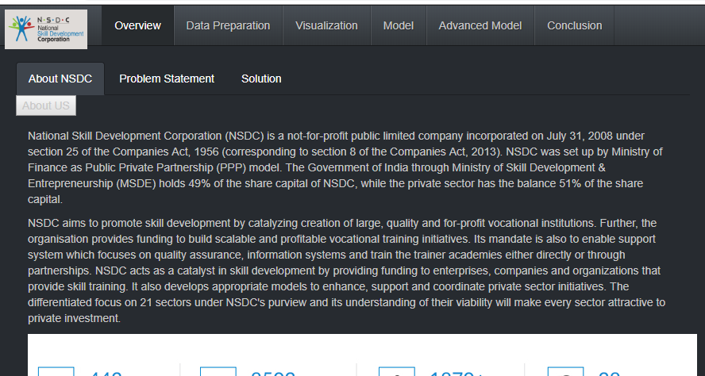
Solution
4 well defined Tabs provided to the user to perform data analysis and derive insights
Data Preparation – for data cleaning and preprocessing
Visualization – To create different visual charts for data interpretation and analysis
Model – To apply basic decision tree algorithm on data to predict probability of placement in this case
Advanced Model – To apply Random Forest and XG Boost algorithms to predict placement probability in this case

Slide 6
Data Preparation
Data Loading
Remove Irrelevant data
Missing Value Analysis
Data Download

Slide 7
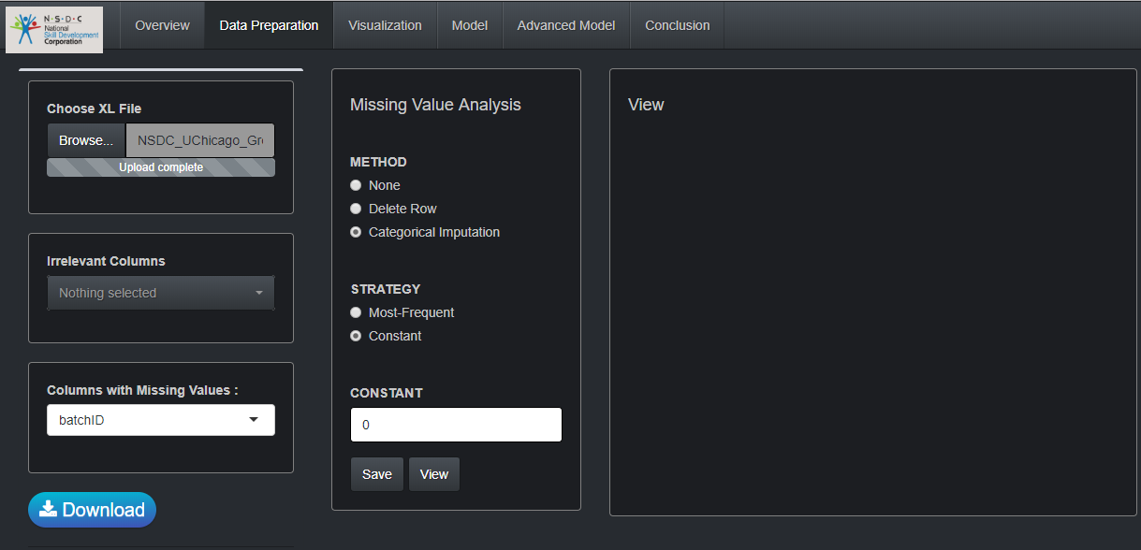
User can browse to select XLS file for data Pre-Processing

Slide 8
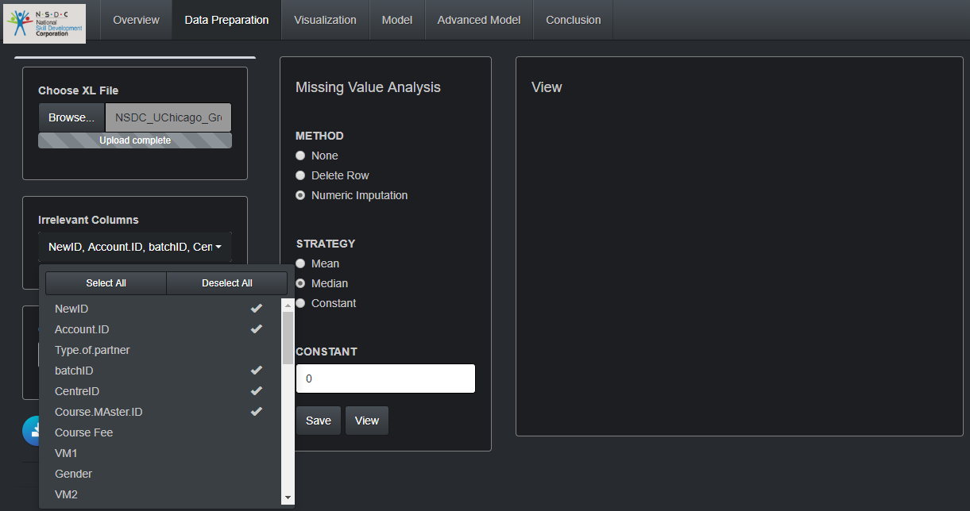
Removing irrelevant columns from the drop down list

Slide 9
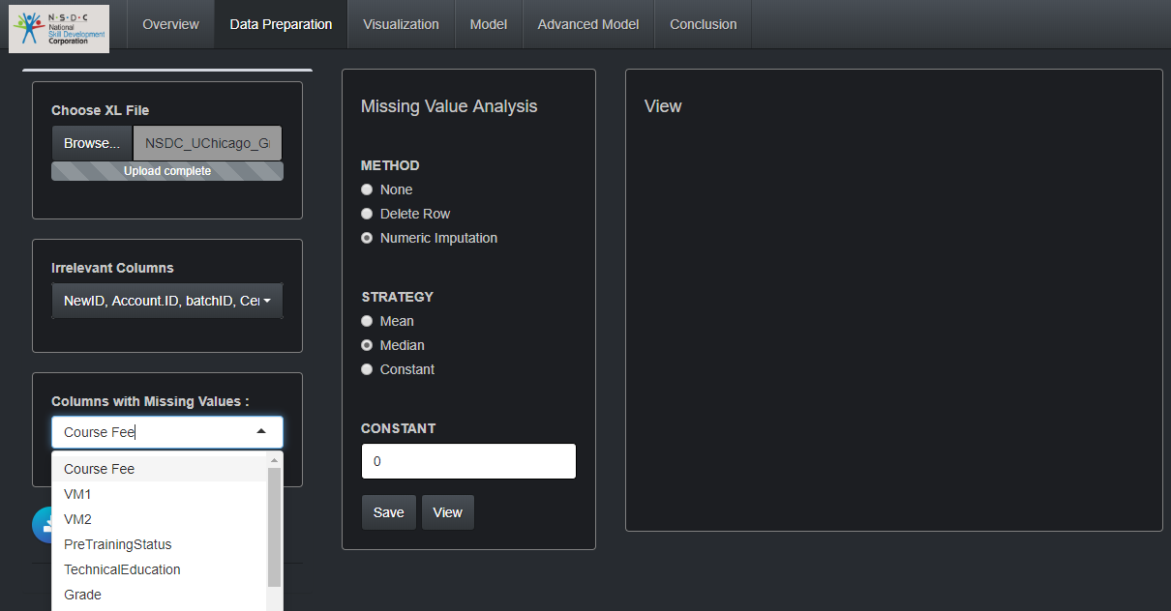
Select a column to analyse missing values and take appropriate course of action

Slide 10
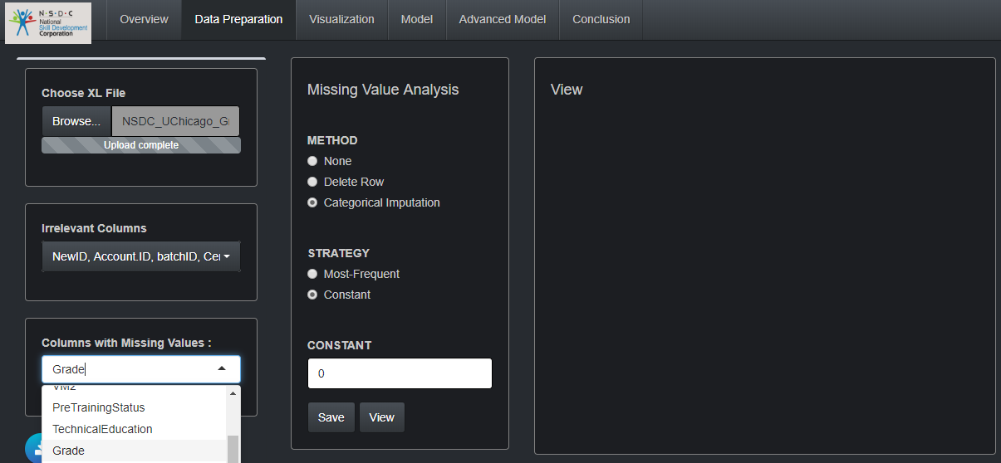
Non-Numerical Columns like Grade shown here can be analyzed for missing values and data imputation can be done using Most-Frequent/Constant strategy.
Once the strategy is applied click on Save Button.

Slide 11
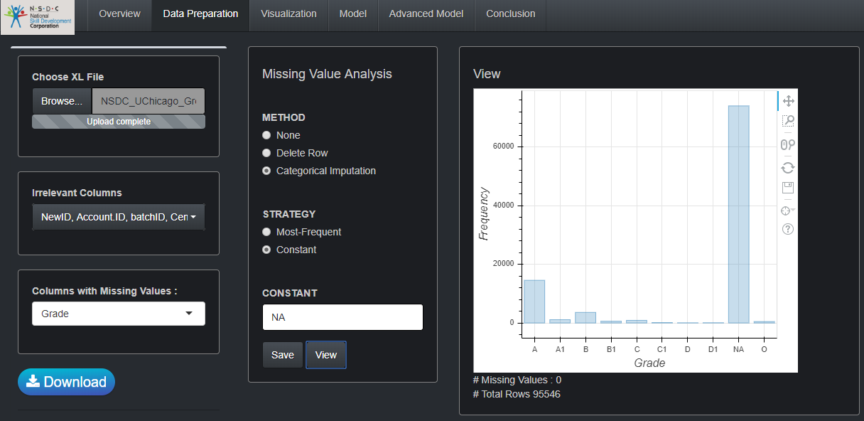
Once View Button is Clicked the graph for values of the selected column will be displayed on view Panel

Slide 12
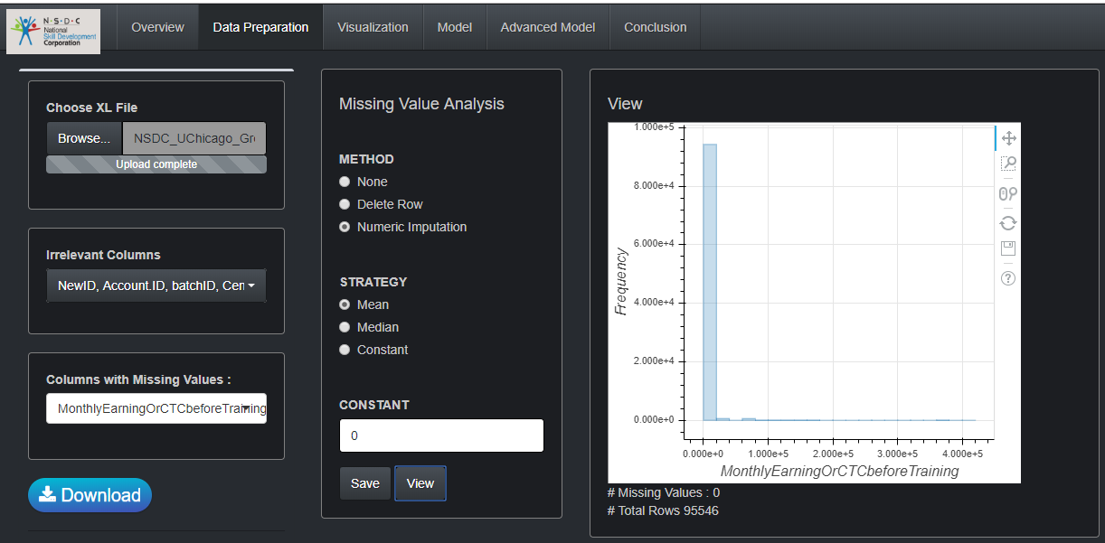
For Numeric Columns, data imputation strategy are as shown
User can download the modified XLS file

Slide 13
Visualization
Visual Charts
User is presented with important visual charts to give quick look at important statistics
Dynamic Interactive Charts
User is given ability to select mix and match of parameters for comparison and derive useful insight.

Slide 14
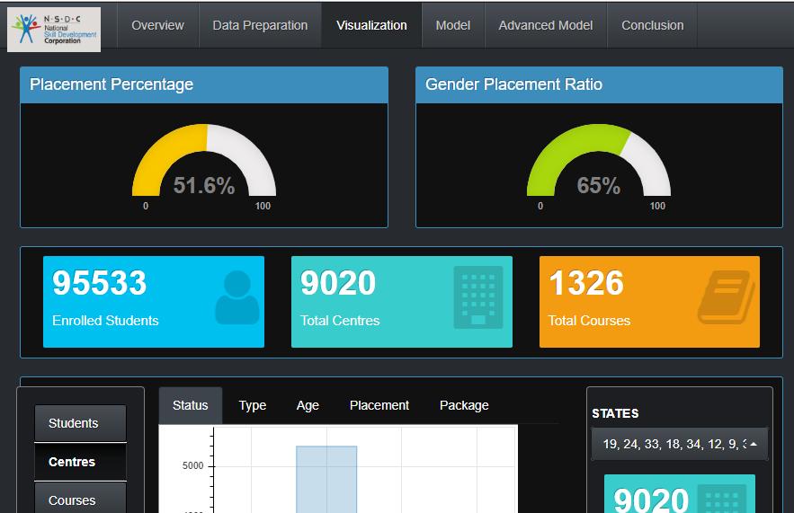
Important Indicators for the users will be generated once User selects Visualization Tab

Slide 15
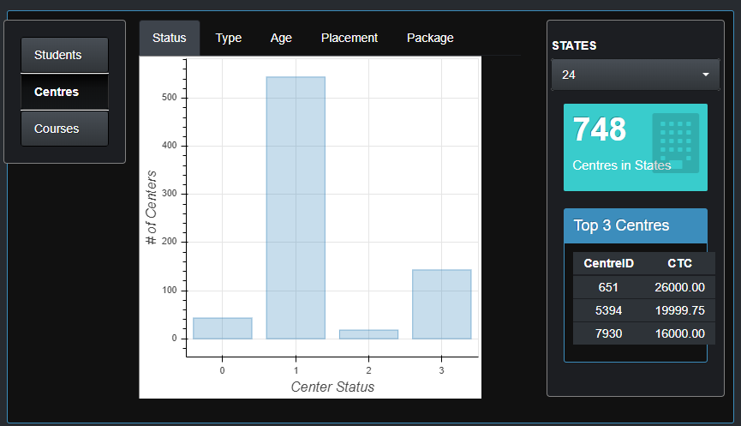
The parameters selected by user will be plotted on Y Axis

Slide 16
Parameters selected by the User will be plotted on X Axis of the chart against the Y Axis selected.

Slide 17
User can apply a filter on States to focus on particular state

Slide 18
For selection done by User, Top 3 centers will be dynamically displayed on right part

Slide 19
Machine Learning Models application
Model
Simple Decision Tree algorithm is applied on the data to return a predictive model to predict success probability
Each level splits the data according to different attributes, the non-leaf nodes are represented by attributes, the leaf nodes represent the predicted variable
Important parameters to determine the accuracy of decision tree are generated
Advanced Model
User can apply Random Forest or XG boost Algorithm to return a
User can select number of folds for performing modelling and then can review model accuracy and feature importance

Slide 20
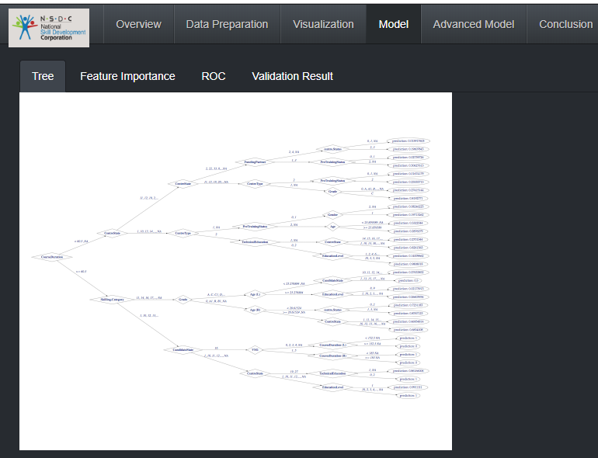
A Decision Tree is created for Pre-Processed data when user selects the ‘Tree’ Tab

Slide 21
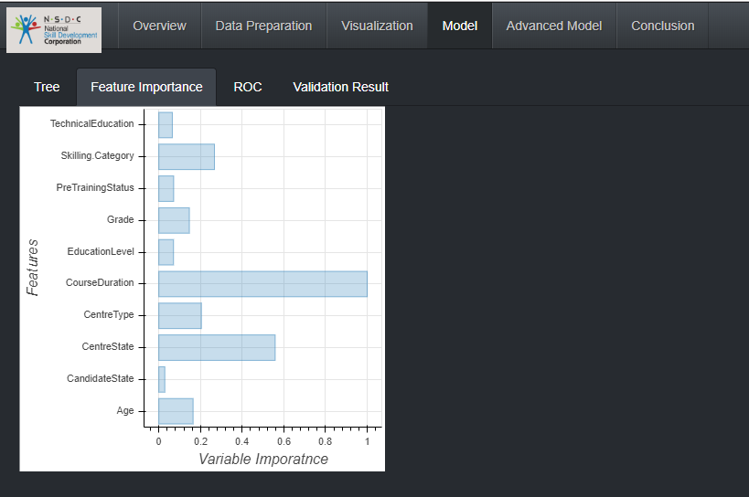
User can see Feature Importance plot on selected the Tab

Slide 22
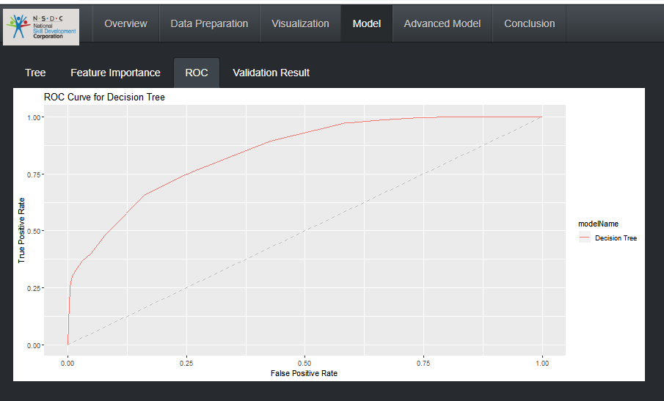
ROC Curve displayed once User selects the ROC Tab

Slide 23
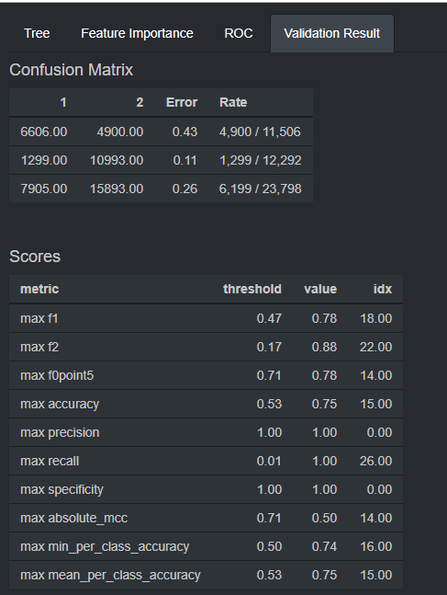
Model Validation Results
User can view various indicators and decide if the model is good enough or he would like to run advanced models on the data.

Slide 24
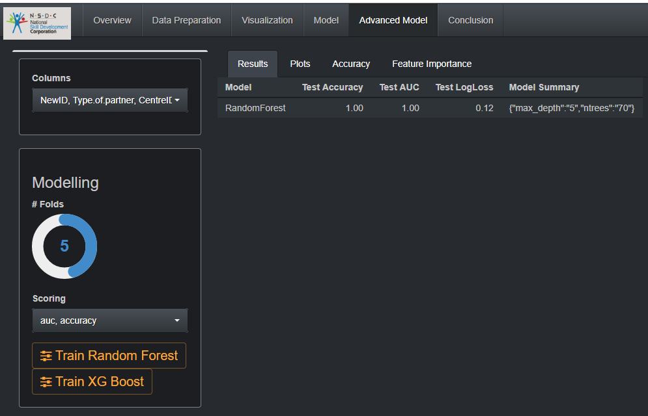
User can select the Number of folds and the predictive model to be train and predict data.
User can view the Testing results for the predictive model selected by the user

Slide 25
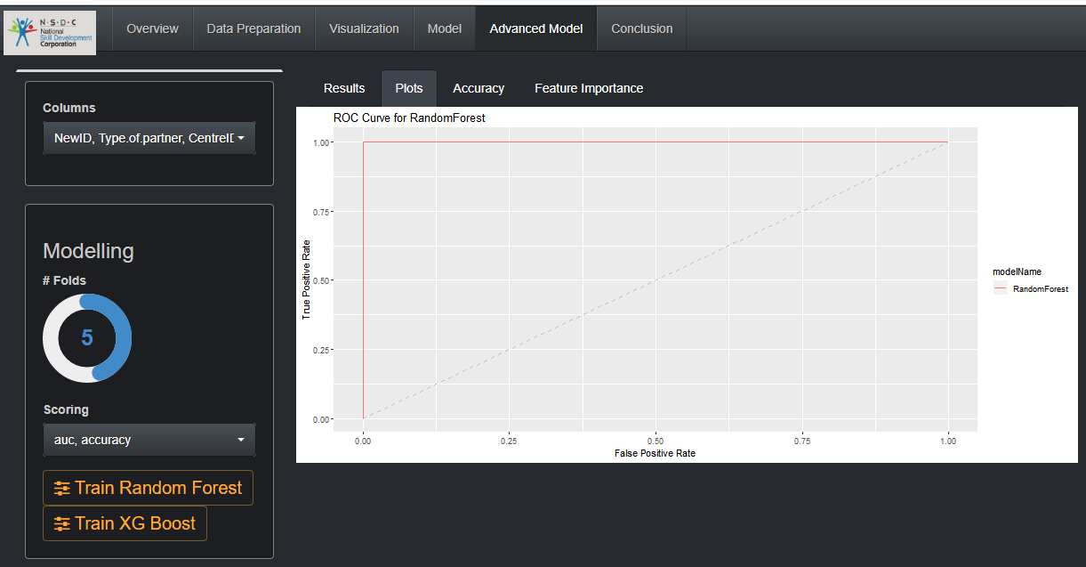
Ussr can view the ROC Curve for the predictive model generated

Slide 26
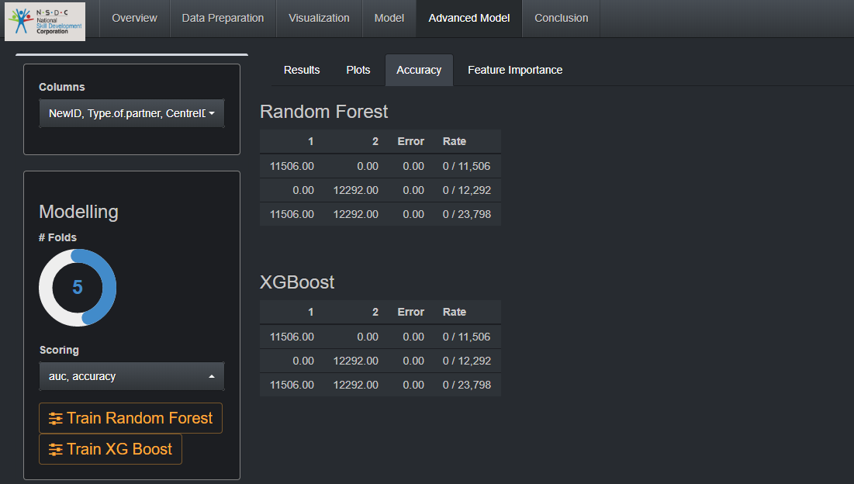
User can generate one or both models and compare the accuracy to determine the better model

Slide 27
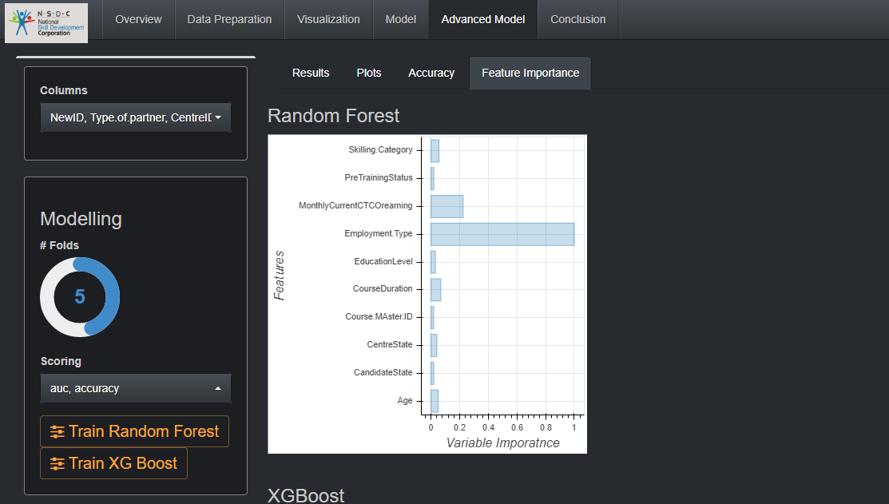
User can Select feature Importance to view Feature Importance graph for the predictive model.

Slide 28
Conclusion – Insights
Age factor
Maximum number of students are between Age group of 18-30 and also those are enrolled to maximum number of courses
Top Courses
For any selected state, one can view top courses so that individual from state can accordingly be counselled
Top earning Skill Set
For a particular skill set, one can check out maximum package to be driven home.

Slide 29
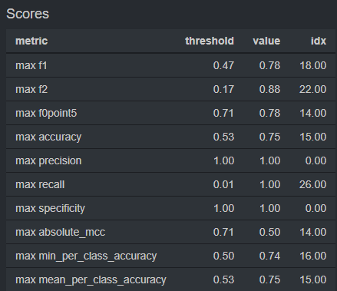
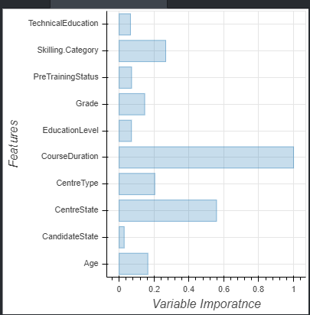
Conclusion – Predictive Modelling
Model
Decision Tree model is running efficiently with below accuracy parameters to predict whether a particular person will be successfully placed or not.
Also, Important features are derived

Slide 30
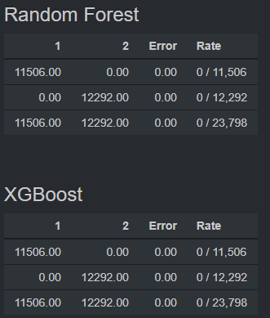
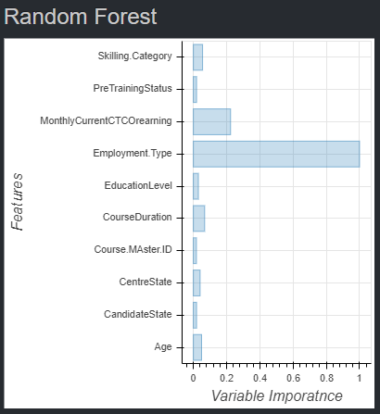
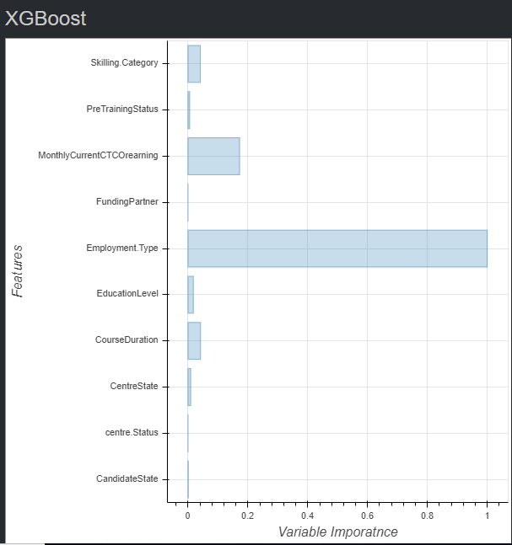
Conclusion – Predictive Modelling
Model
Random Forest and XG Boost models are running more efficiently than decision Tree with below accuracy parameters to predict whether a particular person will be successfully placed or not.
Also, Important features are derived

